Slide 1
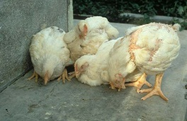
poultry diseases 1
fourth stage
شعار الكلية
Fungal Diseases
Dr.Harith Abdulla
Department of Pathology and Poultry Disease
College of Veterinary Medicine University of Basrah
University of Basrah- College of veterinary medicine- Department of Pathology and Poultry Disease

Slide 2
1.Aspergillosis:
Aspergillosis is defined as a disease caused by infection with the genus Aspergillus, usually of the respiratory system, of chickens, turkeys, and less frequently ducklings and many other wild birds.
The disease has two forms:
1-Acute form in young birds( Brooder Pneumonia).
2-Chronic form in older birds( Sporadic cases ).
Mortality : Up to 100% in young birds.

Slide 3
Etiology: Aspergillus fumigatus
Method of spread:
A-Inhalation of spores.
B-Contaminated eggs.
C-Dusty litter.
Clinical signs:
1-Rapid gasping respiration.
2-Yellow caseous pellet in eyes.
3-Encephalitis.

Slide 4
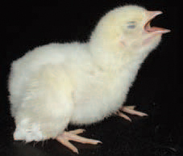
Gasping

Slide 5
Post-mortem lesion:
1- Round yellow caseous granulomas on air sacs
and lungs.
2-Occlusion of trachea by caseous plaques.
3-Sometimes green mold growth on air sacs or
in lungs.
Diagnosis:
1-Case history.
2-Clinical signs.
3-Post-mortem lesions.
4-Histopathology demonstrates the hyphe of the
fungi .

Slide 6
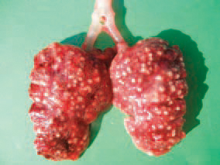
Round yellow caseous granulomas on the lungs.

Slide 7
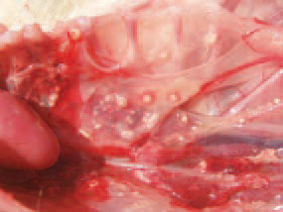
Round yellow caseous granulomas on air sacs

Slide 8
Treatment:
Antifungal (not practical and not economic).
Prevention:
1-Remove source of infection.
2-Fumigate incubator and hatchers.
3-Add antifungal agent to feed.
4-Fumigate litters.
5-Prevention of stress.

Slide 9
2-Thrush:
Moniliasis or Candidiasis or Sour crop.
Etiology:
Monilia albican or Candida albican.
Mycosis of the digestive tract.

Slide 10
3-Favus:
Favus is a chronic dermatomycosis.
Etiology:
Trichophyton megnini

